Slide 1
Central Grievance
Management System (CGMS)

Slide 2
Grievance Resolution Process
Grievance Resolution process in CRA system for PAO

Slide 3
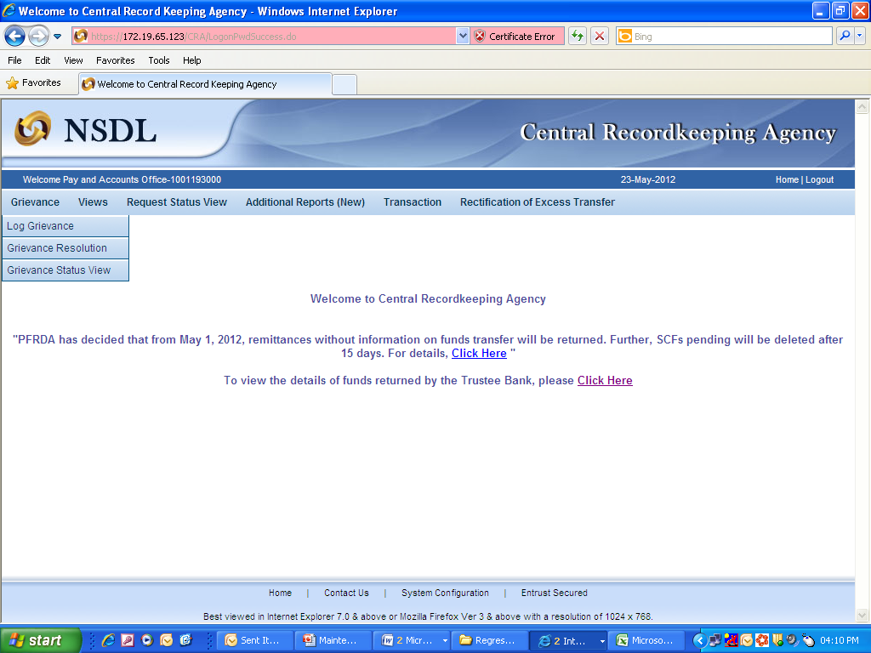
PAO Grievance Resolution View
8

Slide 4
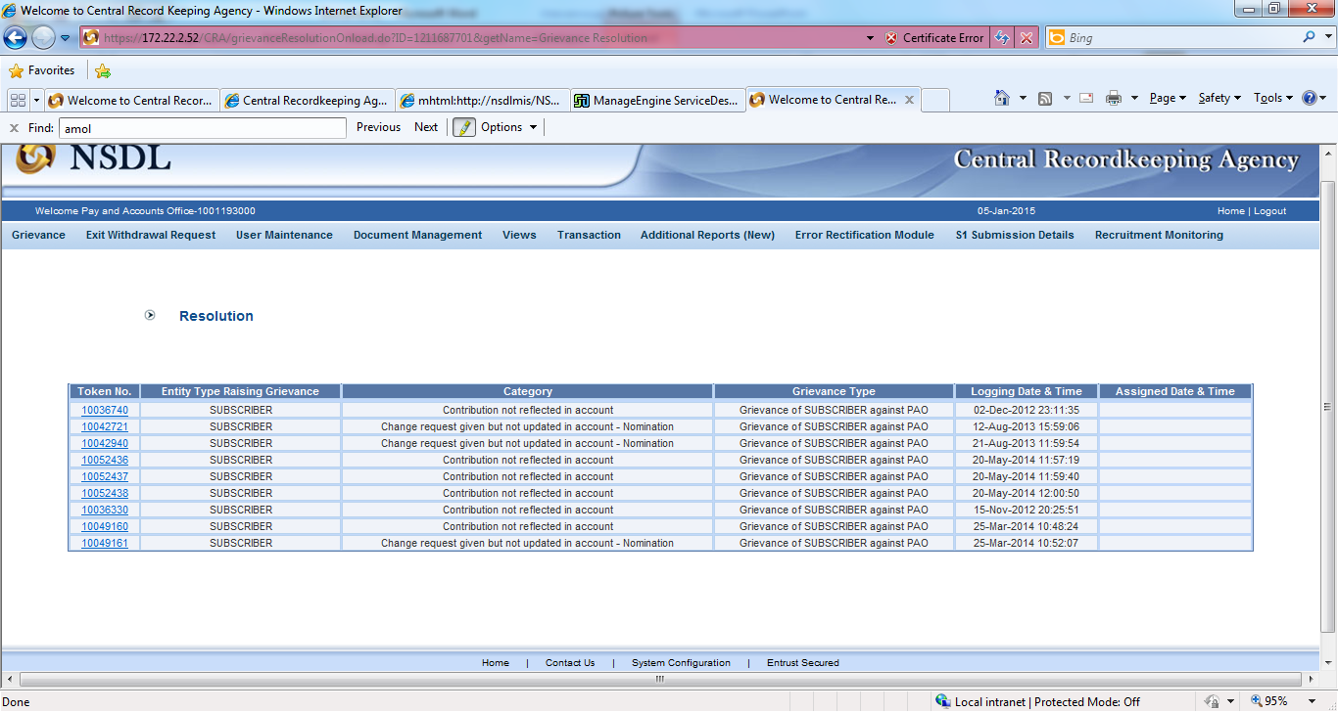
PAO Grievance Resolution View ..(contd.)
9

Slide 5
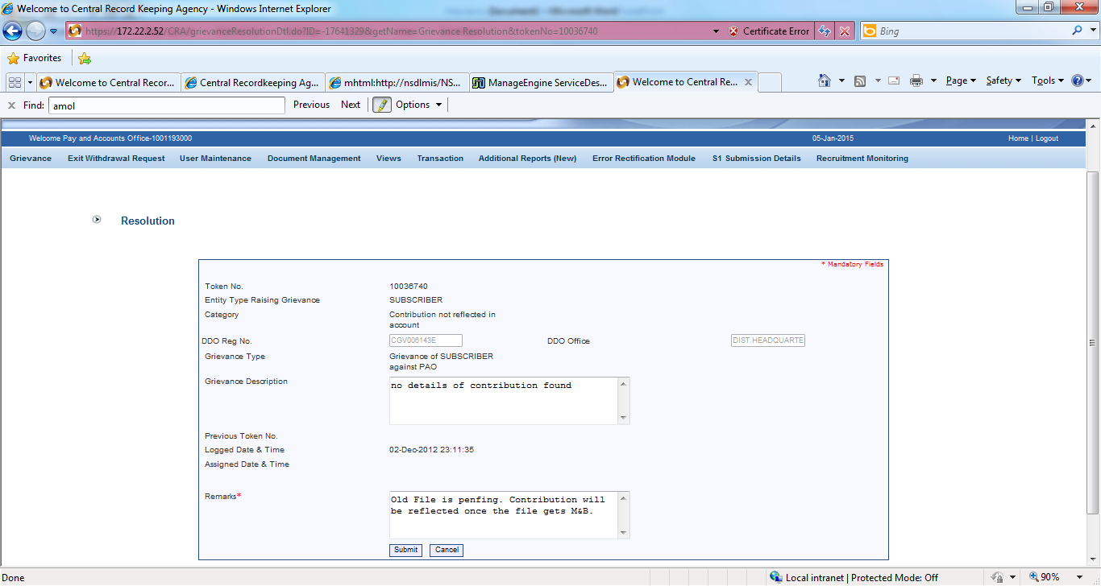
PAO Grievance Resolution View ..(contd.)
10

Slide 6
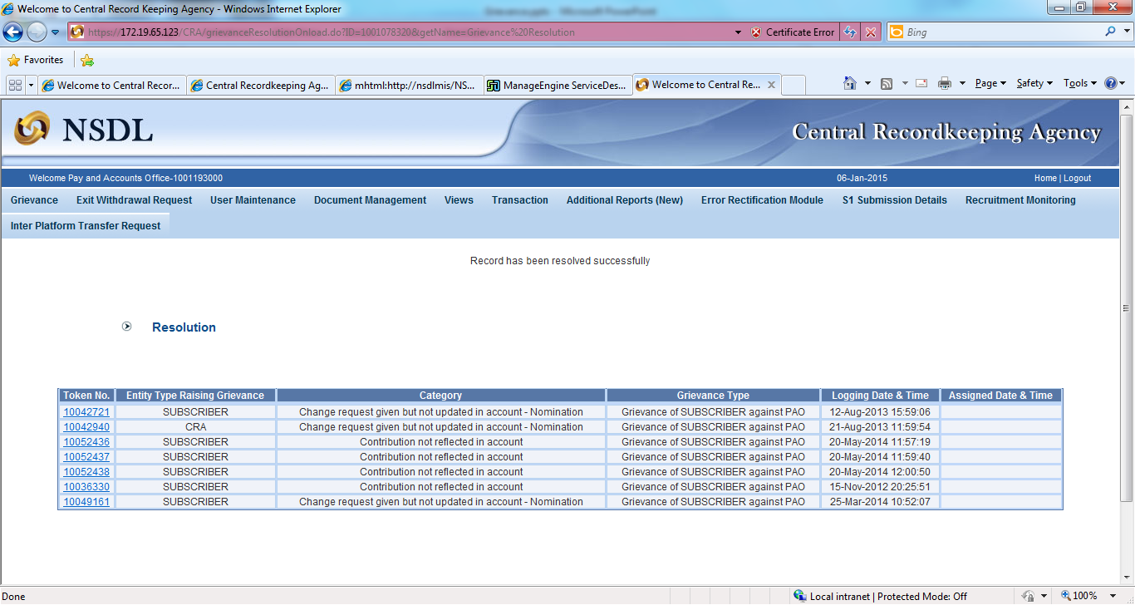
PAO Grievance Resolution View ..(contd.)
11

Slide 7
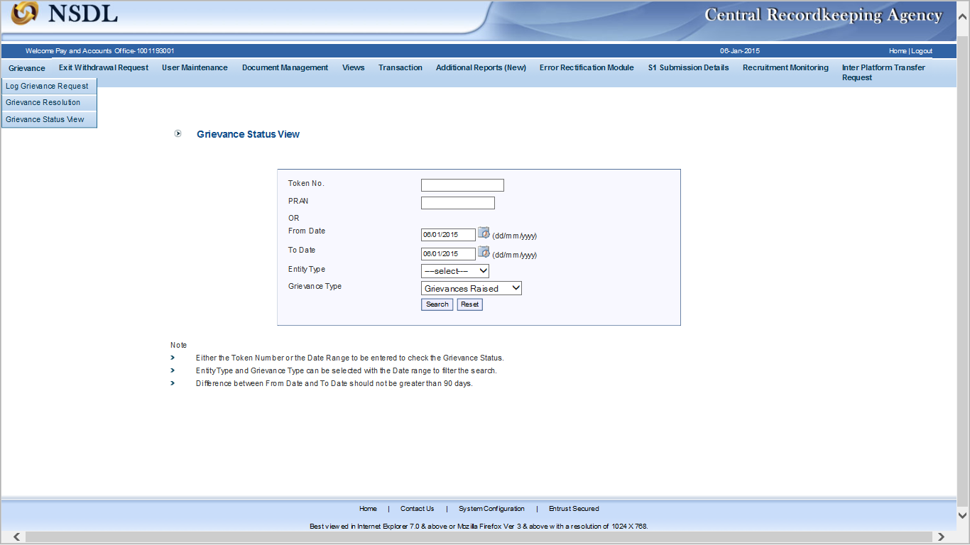
PAO Grievance Status View
12

Slide 8
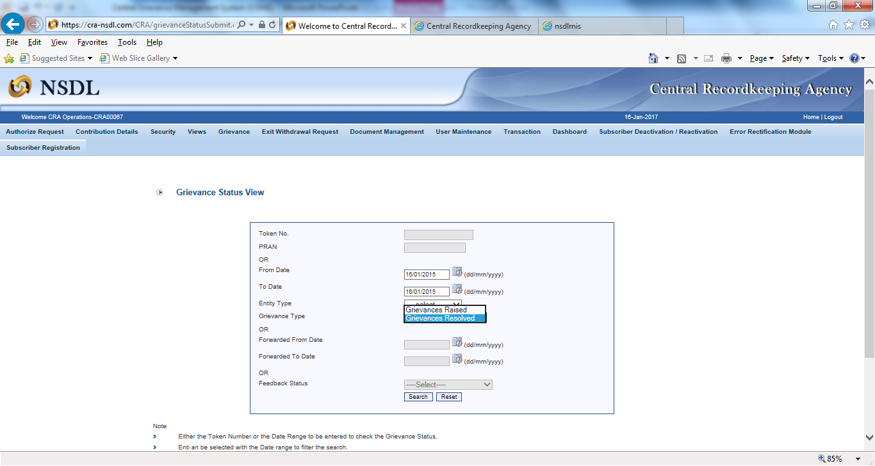
PAO Grievance Status View ..(contd.)
13

Slide 9
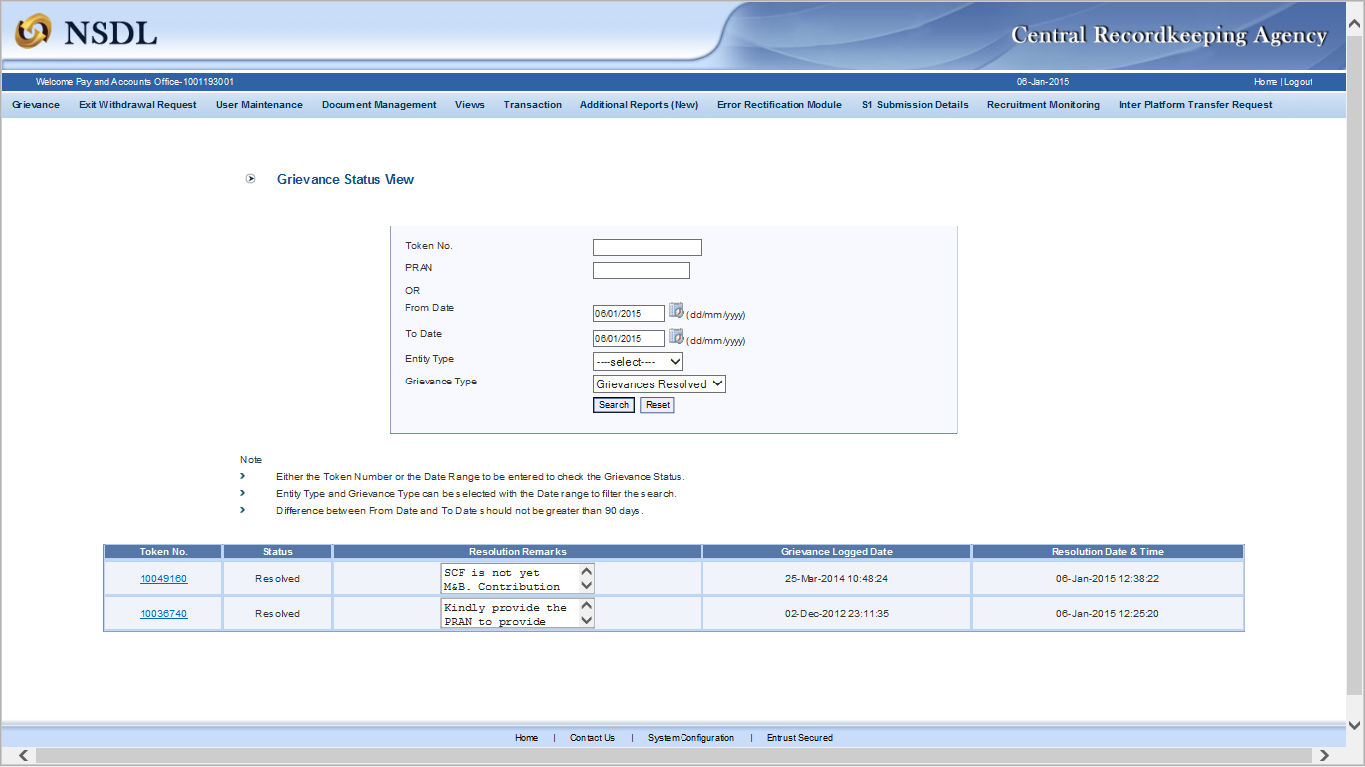
PAO Grievance Status View ..(contd.)
14
Notes:
Input can be token no or data range. PAO can click on hyperlink of token no to view the grievance.
Complete details of grievance along with resolution details (if resolved) will be shown.

Slide 10
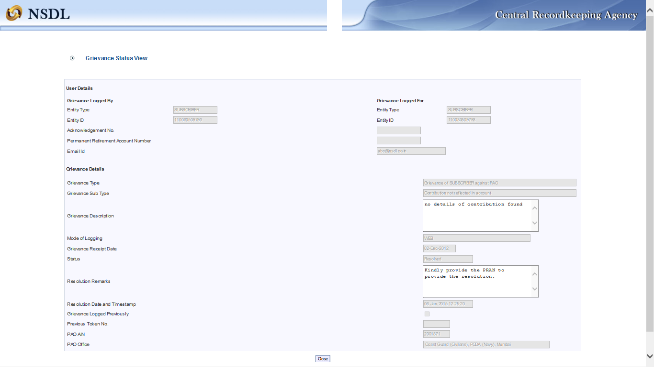
PAO Grievance Status View ..(contd.)
15

Slide 11
THANK YOU

